Slide 1
VPC Summary 1

Slide 2

Agenda
What is VPC?
Benefits of VPC.
VPC use cases.
VPC Concepts.
Security in VPC.

Slide 3
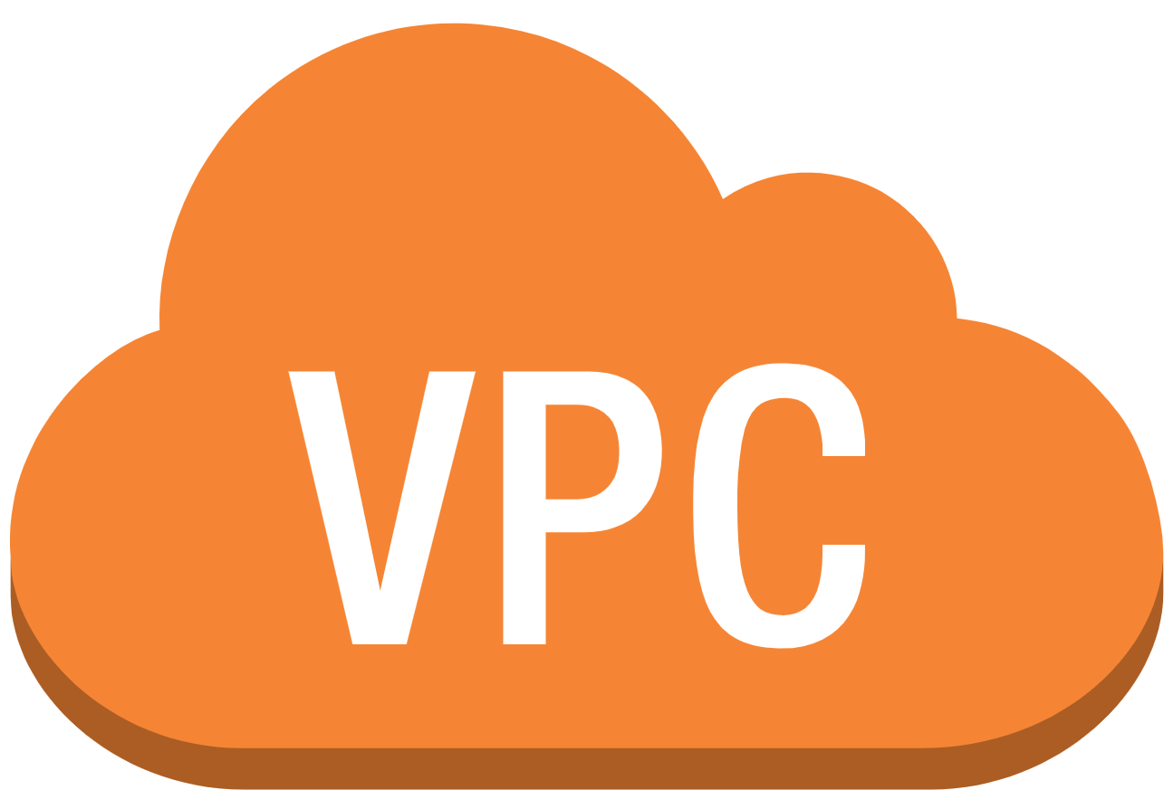
VPC
Deploy AWS resources in a logically isolated virtual network.
Control over our virtual networking environment.
Both IPv4 and IPv6.
Have a public-facing subnet.

Slide 4
Benefits of VPC
Secure network connections.
Easy setup.
Customization of the virtual network.

Slide 5
VPC Use Cases
Creation of a basic public-facing website.
Host multi-tier web applications.
Connect cloud applications to the data centre securely.
Backup can be used to retrieve our data.

Slide 6
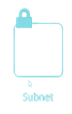
Important Concepts in VPC
Subnet:
A logical subdivision of an IP network.
Process of separating a network into two or more networks.
Public and Private subnet.
Allows the internet to access the machine.
Private subnetting keep the computer hidden.

Slide 7
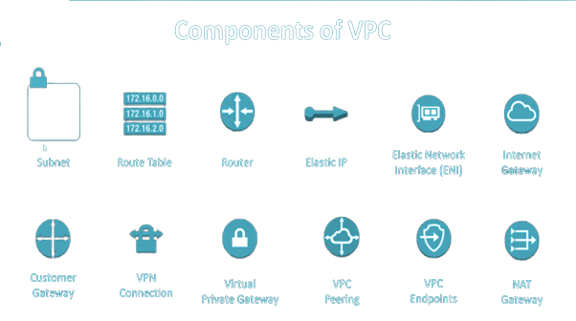
Important Concepts in VPC
Route Table:
Made up of a set of rules which known as routes.
Destination and a target are specified for each route.
Primary route table comes with our VPC by default.
Responsible for routing for any subnets.

Slide 8
Important Concepts in VPC
Internet gateway:
Connection between our VPC and internet.
Horizontally scaled.
Redundant.
Highly available.

Slide 9
Important Concepts in VPC
Acts as a target.
VPC route tables for internet-routable traffic.
Performs network address translation,
for instances with public IPv4 addresses.

Slide 10
Important Concepts in VPC
Network interfaces:
Logical networking component.
Represents a virtual network card.
An Elastic Network Interface.

Slide 11
Important Concepts in VPC
VPC Endpoints:
Create private connections between
Our VPC and AWS services that are supported.
Enabled by AWS Private Link.
Private IP addresses to access services discreetly.

Slide 12
Security
Doesn’t compromise on security.
Shared responsibility model applies to data protection.
Assist and ease the customer's operational burden.
AWS Identity and Access Management to protect AWS account credentials.

Slide 13
Security
Multi-factor authentication.
Log API and user activity.
Need FIPS 140-2 verified cryptographic modules.
US and Canadian government standard.

Slide 14
Security
Monitor our VPC components and VPN connections.
Record IP traffic to and from network interfaces.
Create, distribute, rotate, and revoke AWS access credentials.
Security groups and use traffic mirroring.

